Slide 1

Oracle11g:
PL/SQL Programming
Chapter 5
Procedures

Slide 2
Chapter Objectives
After completing this lesson, you should be able to understand:
  Named program units
  Creating a procedure
  Calling a procedure from another procedure
  Using the DESCRIBE command with procedures
  Debugging procedures using DBMS_OUTPUT
Oracle11g: PL/SQL Programming

Slide 3
Chapter Objectives (continued)
After completing this lesson, you should be able to understand (continued):
  Using subprograms
  The scope of variables, exception handling and transaction control
  Using RAISE_APPLICATION_ERROR for error handling
  Removing procedures
Oracle11g: PL/SQL Programming

Slide 4
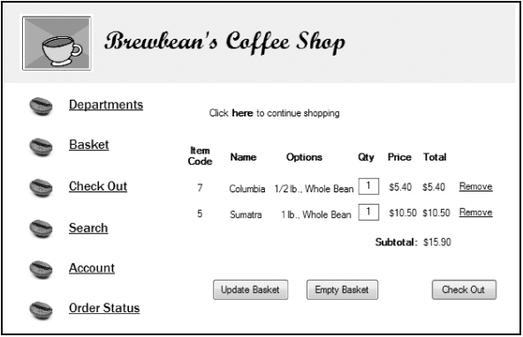
Brewbean’s Challenge
Develop programming modules for specific tasks such as calculating
taxes or updating inventory
Oracle11g: PL/SQL Programming

Slide 5
Named Program Units
PL/SQL blocks executed thus far have been anonymous blocks
Now we will assign a name to the block and save it in the database as a stored program unit
This makes program units reusable
Oracle11g: PL/SQL Programming

Slide 6
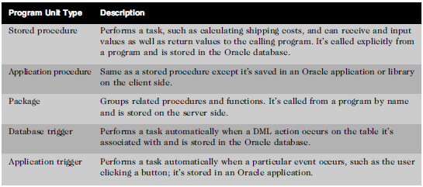
Types of Program Units
Oracle11g: PL/SQL Programming

Slide 7
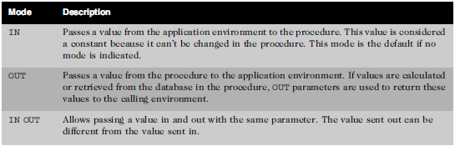
Parameters – Make Program Units Reusable
Mechanisms used to send values in and out of program units
Oracle11g: PL/SQL Programming

Slide 8
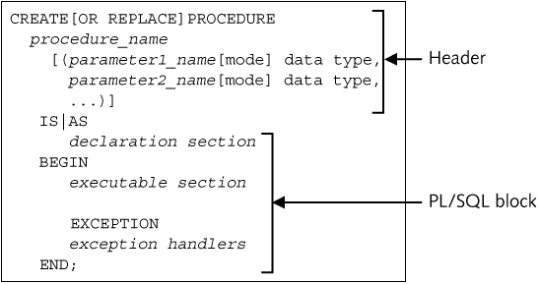
Create Procedure Statement Syntax
Oracle11g: PL/SQL Programming

Slide 9
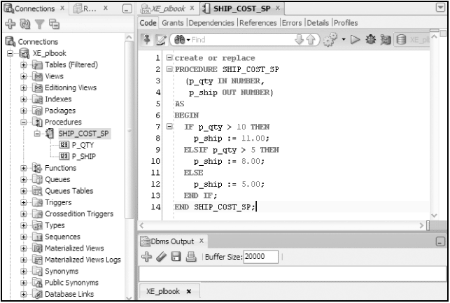
Create Procedure Execution
Procedure to determine shipping cost
Oracle11g: PL/SQL Programming

Slide 10
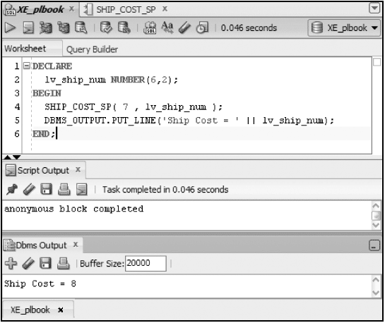
Execute/Test the Procedure
Declare a variable to hold value from OUT parameter
Call procedure addressing both parameters
Display value returned to verify
Note: Parameter arguments are passed positionally by default
Oracle11g: PL/SQL Programming

Slide 11
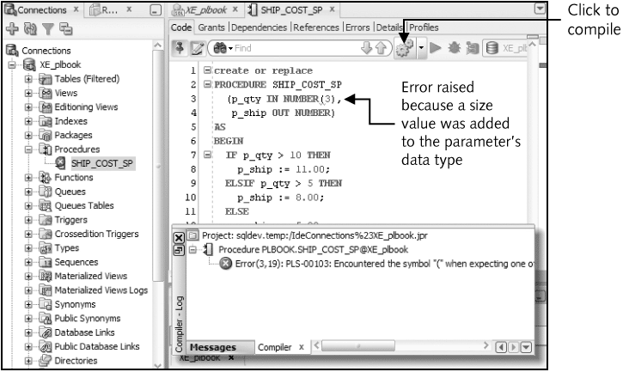
Compilation errors
Oracle11g: PL/SQL Programming

Slide 12
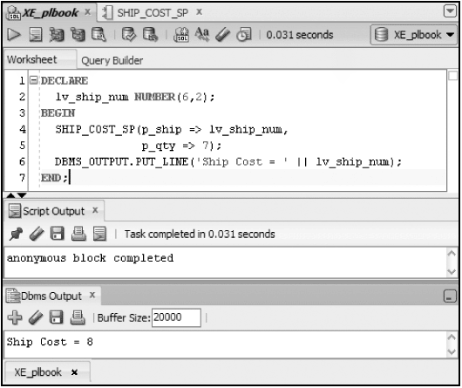
Named Association Method
Provide parameter values by position (default) or name
Oracle11g: PL/SQL Programming

Slide 13
IN OUT mode
Send value in and out via the same parameter
CREATE OR REPLACE PROCEDURE phone_fmt_sp
(p_phone IN OUT VARCHAR2)
IS
BEGIN
p_phone := '(' || SUBSTR(p_phone,1,3) || ')' ||
SUBSTR(p_phone,4,3) || '-' ||
SUBSTR(p_phone,7,4);
END;
Oracle11g: PL/SQL Programming

Slide 14
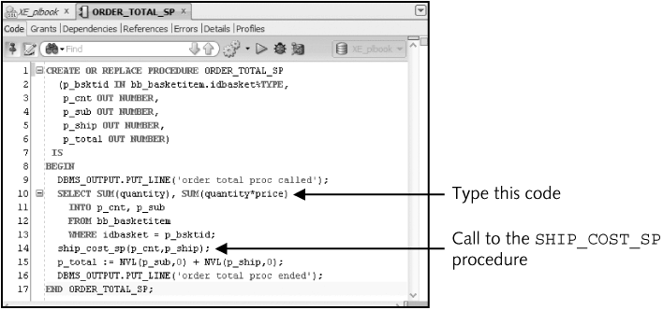
Calling a Procedure from another procedure
Oracle11g: PL/SQL Programming

Slide 15
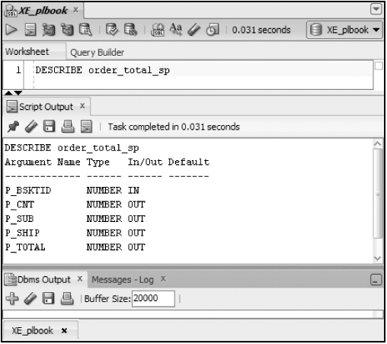
DESCRIBE Command
Lists the parameters of a program unit
Oracle11g: PL/SQL Programming

Slide 16
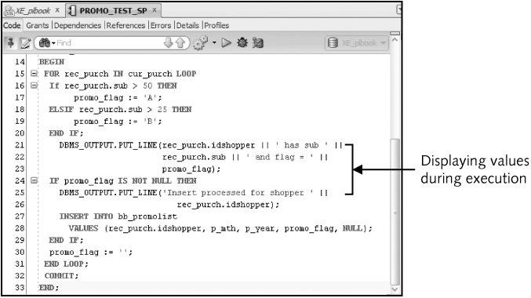
Debugging with DBMS_OUTPUT
Oracle11g: PL/SQL Programming

Slide 17
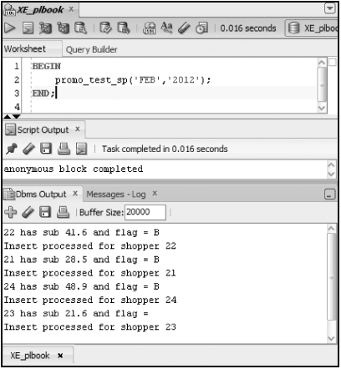
Debugging with DBMS_OUTPUT
Oracle11g: PL/SQL Programming

Slide 18
Subprograms
A program unit defined within another program unit
Must be declared in the DECLARE section of the containing program unit
Can only be referenced by the containing program unit
Oracle11g: PL/SQL Programming

Slide 19
Variable Scope
When nesting blocks, are variables shared?
Inner blocks can use variables from outer blocks
Oracle11g: PL/SQL Programming

Slide 20
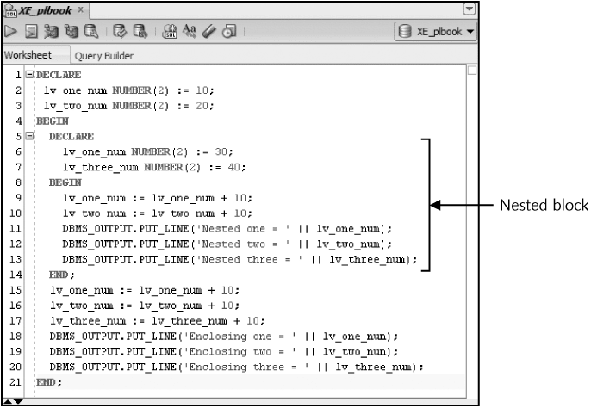
Variable Scope (continued)
Oracle11g: PL/SQL Programming

Slide 21
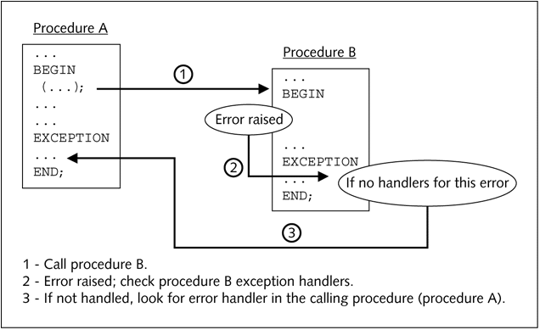
Exception-HandlingFlow
Oracle11g: PL/SQL Programming

Slide 22
Transaction Control Scope
The scope refers to the group of DML statements that are affected by a particular transaction control statement
By default, a session has a single DML queue and a transaction control statement would affect all DML in the queue regardless of which program unit initiated the statement
DML statements of a program unit can be treated separately or as an autonomous transaction
Oracle11g: PL/SQL Programming

Slide 23
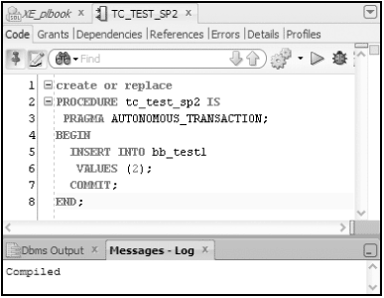
Autonomous Transaction
Oracle11g: PL/SQL Programming

Slide 24
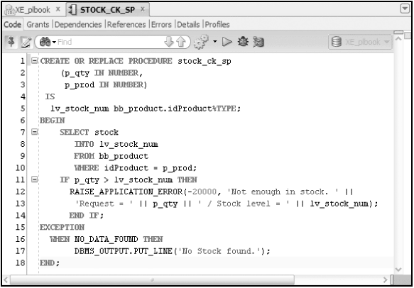
RAISE_APPLICATION_ERROR
Oracle11g: PL/SQL Programming

Slide 25
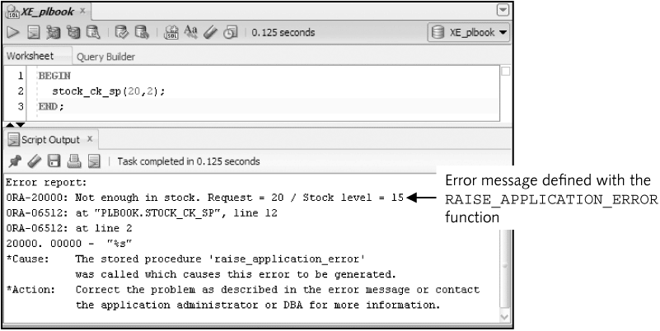
RAISE_APPLICATION_ERROR (continued)
Oracle11g: PL/SQL Programming

Slide 26
Remove a Procedure
DROP PROCEDURE procedure_name;
Oracle11g: PL/SQL Programming

Slide 27
Summary
Named program unit assigns a name to a program unit so it can be reused
Parameters are used to pass values in and out of program units
Stored program units are saved in the database
Parameter modes include: IN, OUT, and IN OUT
Use DBMS_OUTPUT.PUT_LINE statement to debug
Oracle11g: PL/SQL Programming

Slide 28
Summary (continued)
A subprogam is a procedure declared within another procedure
Variable scope must be considered with nested blocks
Autonomous transactions must be explicitly created
The RAISE_APPLICATION_ERROR function enables programmer defined errors
Remove a procedure with the DROP PROCEDURE command
Oracle11g: PL/SQL Programming

